Slide 1
Introduction
Dr. Sanatan Chattopadhyay
Department of Electronic Science
&
Centre for Research in Nanoscience and Nanotechnology
University of Calcutta

Slide 2
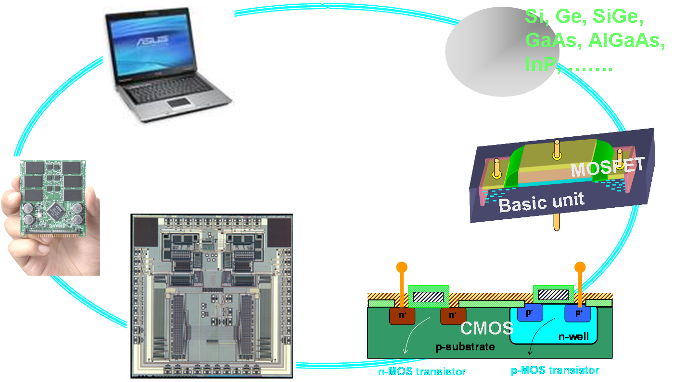
Systems, circuits and devices

Slide 3
Developing an electronic system
Material
Device/Circuit
Circuit/System
Material synthesis
Material processing
Material modeling
Transport study
Computation
Device design
Device modeling
Contacts
Simulation
Devices
Integrated circuits (IC)
Systems
Components
Interconnects

Slide 4
Metal-oxide-semiconductor field effect transistors (MOSFETs)
The workhorse of modern electronic gadgets

Slide 5
Si based CMOS is the key
As a material
Market
Si is abundant in nature
Microelectronic market
High quality native oxide (SiO₂)
80% is dominated by CMOS**
Appropriate mechanical strength
97% is covered by Si
Complementary-Metal-oxide-Semiconductor (CMOS).
P - Metal-Oxide-Semiconductor Field Effect Transistor (p-MOSFET).
N - Metal-Oxide-Semiconductor Field Effect Transistor (n-MOSFET).
CMOS is a combination of an n-MOSFET and p-MOSFET.

